Slide 1



Slide 2
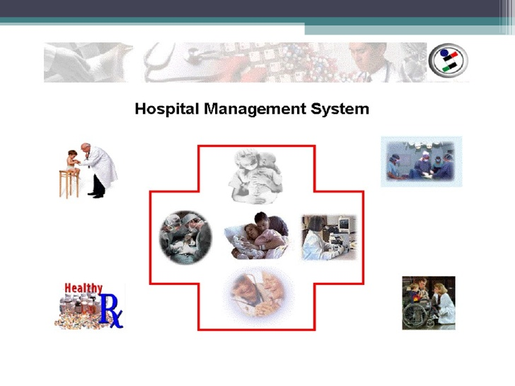

Slide 3
HOSPITAL MANAGEMENT SYSTEM
Presenters:
Fizzah mukhtar
Rida zahoor siddiquie
Akif aijaz
Usman ahmed khan

Slide 4
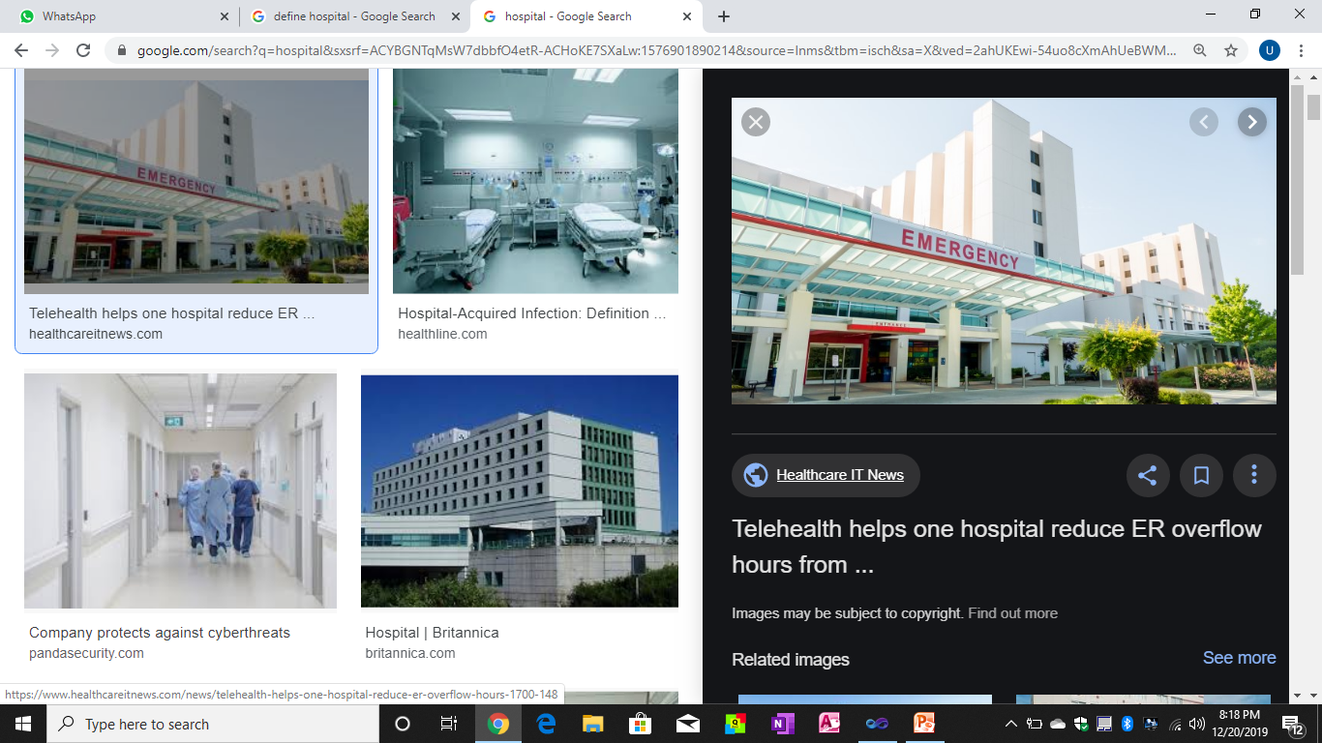
INTRODUCTION
What is hospital?
It is an institution
which provides
medical and
surgical treatment,
nursing care for
sick and injured
people.

Slide 5
CLASSIFICATION OF HOSPITAL
Hospital can be classified on the following basis
1- basing on objective
a. general hospitals
b. special hospitals
2- basing on administration, ownership, control or financial income
a. governmental or public
b. non governmental or private
c. semi govt hospital
d. voluntary agency hospitals

Slide 6
3- basing on length of stay
a. short term or short stay hospitals(stay less than 30 days)
b. long term or long stay hospitals(stay more than 30 days)
4- depending on type of medical staff
a. closed staff hospital
b. open staff hospital

Slide 7
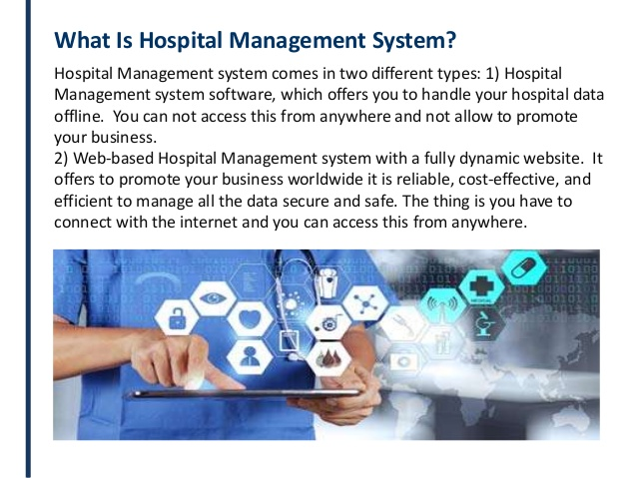
WHAT IS HOSPITAL MANAGEMENT SYSTEM

Slide 8
DEPARTMENTS
Following are some of the departments in a hospital:
Accident and emergency department
Admission department
Anesthetics
Burn center
Cardiology
Central sterile services department

Slide 9
Coronary care unit
Diagnostic imaging
Discharge lounge
Elderly services
Finance department
General surgery
Intensive care unit etc.

Slide 10
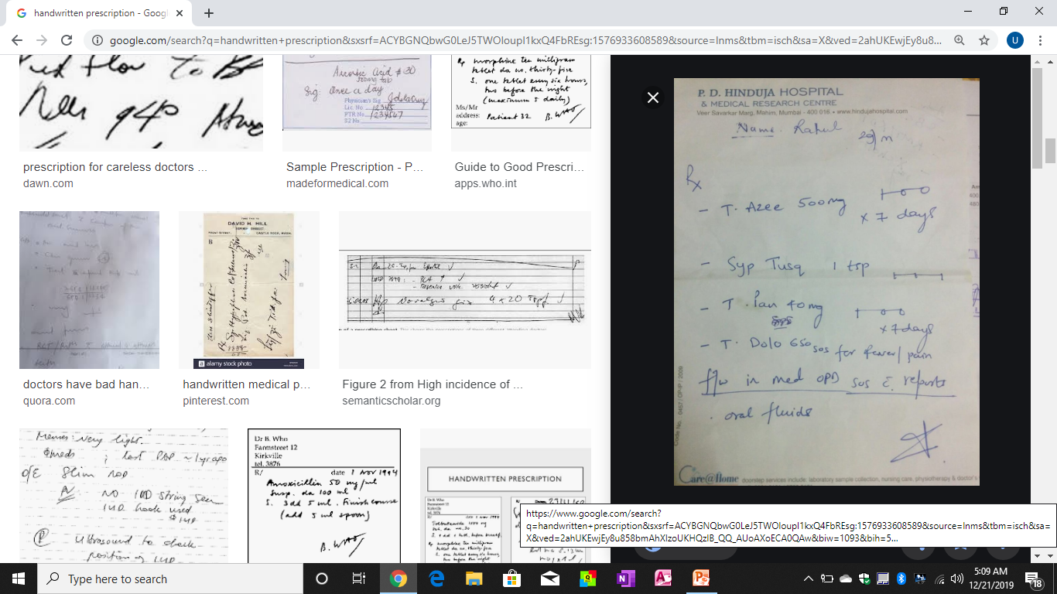
HAND WRITTEN PRESCRIPTION

Slide 11
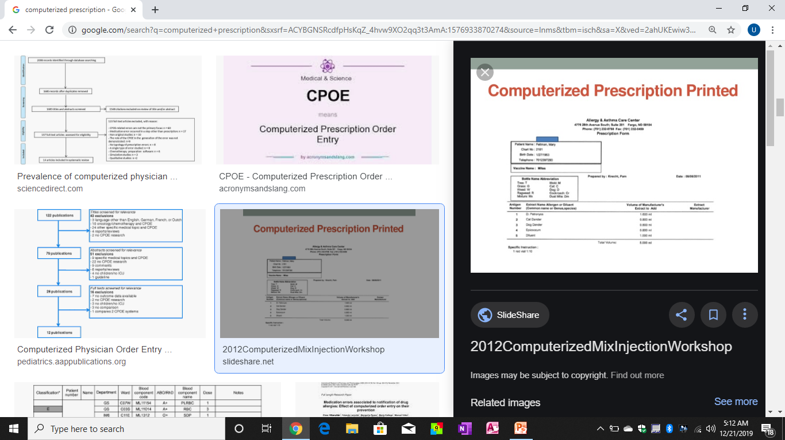
COMPUTERIZED PRESCRIPTION

Slide 12
Staff
It includes names and timings of the nurses and ward boys on duty with their respective ward numbers.
The instructions given to the nurse for each patient are entered in the system.

Slide 13
Doctors
It includes the list of the doctors and their schedules.
It also includes doctors’ emergency numbers.
It includes list of the available medicines for specific diseases so that the doctor can easily look for an alternative when in need.
The patient can be given an appointment referring to the doctors’ schedule.
The use of HMS makes the co-ordination between a doctor and patient easy.

Slide 14
Patient information
An electronic medical record system is in-built which stores all the basic and medical details of the patient.
New patients are registered the same way.
One can also add a feature to store photos of the patients as identity proof which can also help in cases of false identities.

Slide 15
Occupancy
Using HMS, one can check the availability of rooms so that the receptionist can adjust transfer of patients or allot the bed to the new patient.
This data is constantly updated to keep a track of discharged patients.
It also includes the detailed schedule of the operation theatres.
This helps the receptionist to know room is available for other surgeries.

Slide 16
Supplies control
Inventory can be maintained about the stock of supplies in the hospital like surgical instruments, medications, laboratory supplies, staff supplies, etc.
This record helps the administration to have a quick look at the usage and keep a control on the wastage of the supplies.

Slide 17
Billing
A separate section is meant for billing purposes.
It helps to sum up all the expenses of a patient at one time and produce a complete bill at the end of the consultation or at discharge.

Slide 18
Insurance
The respective insurance company can check the details and further the process of passing the claim.
The data is then stored in the database and can be recovered for any later use by the hospital or patient or insurance company.

Slide 19
Laboratory
When doctor advises a certain list of tests to the patients, it is updated in HMS and directly received by laboratory.
It helps to reduce errors caused by the staff.
All the data is fed in the system, one can review the past reports of the patients anytime.
It also includes details of the blood bank.

Slide 20
Employees
It includes information of employees which include their contact numbers, address along with professional details.
Medical details of the employees are also entered for their benefit.

Slide 21
Statistical Reports
All the data is integrated and can be analyzed.
It helps in creating a statistical database for the internal use of the hospital which can be submitted to the administration.
It also helps the administration to summarize the expenses of hospital and evaluate necessary and unnecessary expenditure.

Slide 22
Telehealthcare
A Web based HMS can be used for providing online services to patients, appointments and obtaining opinions of consultants sitting away from the hospital set up.
With the help of this system one can access all the essential information anytime and anywhere.
Another advantage is that it can be modified and customized to suit a small hospital too.
As it provides multiple facilities, therefore it helps in reducing hospital costs, which in turn reduces the expense of quality healthcare for the patient.

Slide 23



